Slide 1

GTZAN Ensemble Machine Learning-Based Audio Genre Classification
Group 3
By Mateusz Ajose, Amelie Gonzalez , Oliver Longley,
Bernard Mendoza, Daniel Perry, Conor Woollatt

Slide 2
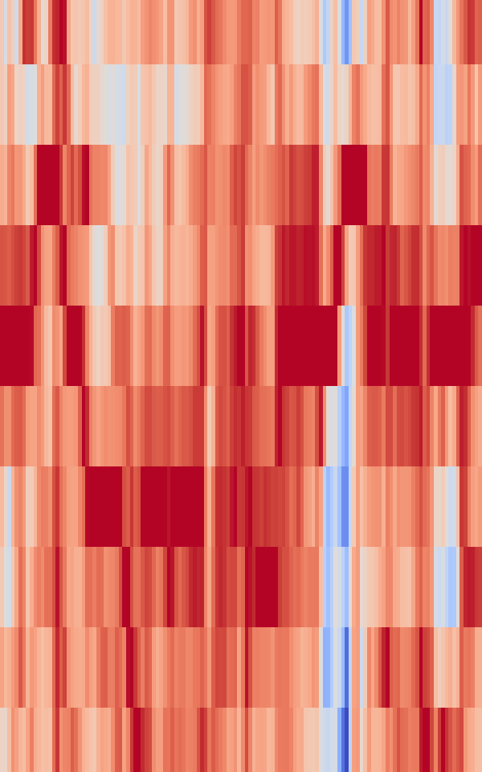
OUR PROJECT OUTLINE AND GOALS
Using the GTZAN dataset (1000 WAV files, 10 genres).
Compare the accuracy of different audio visualisations for genre classification.
Analyse accuracy across all genres, easy (Classical vs. Metal) and hard (Disco vs. Pop) pairs, and five random genres.
Build a final ensemble model incorporating statistical data and CNNs to improve genre recognition.

Slide 3
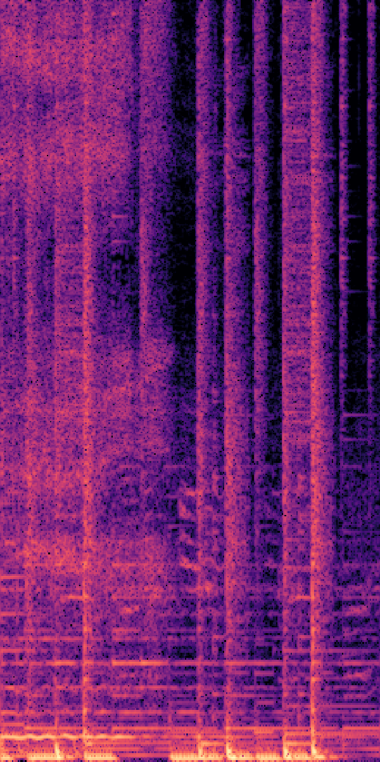
Steps for the project
Test raw WAV files and extracted CSV statistics.
Generate various audio feature visualisations using Librosa.
Train CNNs on visual representations to assess effectiveness.
Build an ensemble combining top CNNs and CSV features

Slide 4
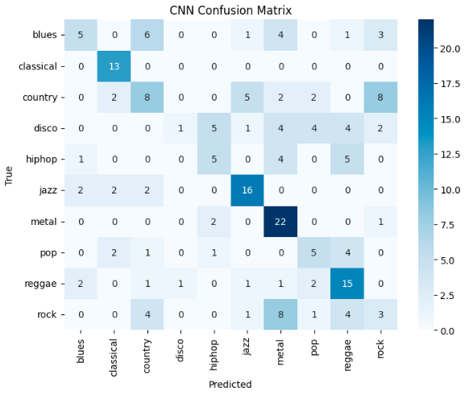
How we worked with the data
Used an 80/20 train-test split.
Created 3s and 30s visualisations for all genres, padding 3s clips to prevent uneven input shapes.
Tested models: Chromagram, Mel-Spectrogram (32, 128, 512 n_mel_values), Onset HeatMap/Images, Spectrogram (256, 512 hop_lengths).
Saved images at 256x256 (except Chromagrams: 36x256).
Set sampling rate to 22,050 Hz.
Trained CNNs for between 20 to 30 epochs on average.
Used confusion matrices to assess model accuracy per genre.

Slide 5
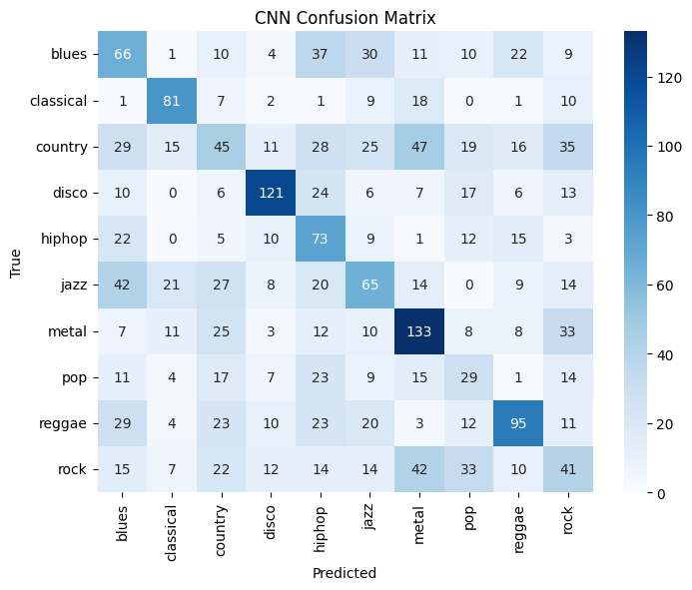
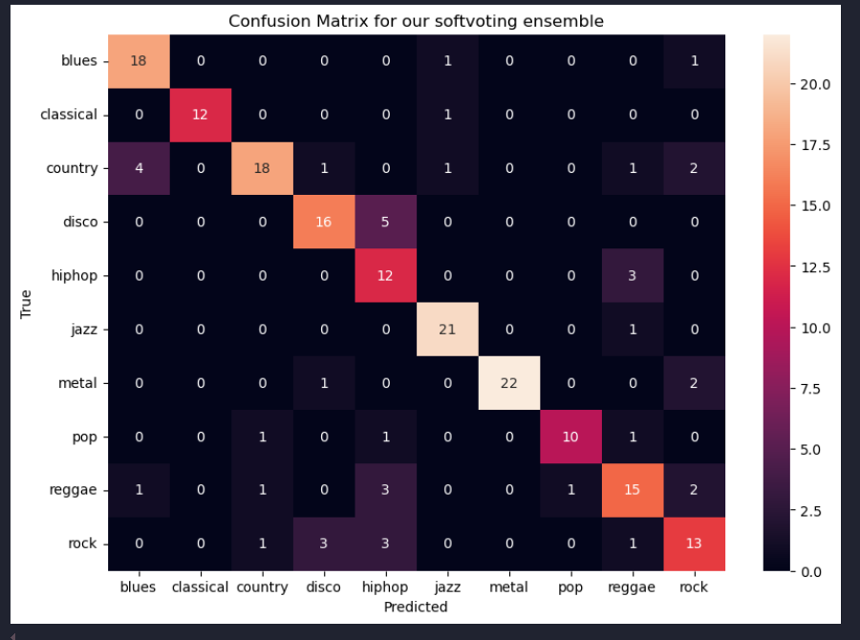
How we visualised our results
Above are diagrams of confusion matrices of ensembles we created.
The numbers in the graphs represent the amount of votes a genre would receive when it came to predicting it
The diagonal line representing correct votes whilst outer cells represent the incorrect ones.

Slide 6

Tools used
Python 3.9.6 (for all other libraries to work effectively)
Jupyter Notebooks
pip libraries:
NumPy, Pandas, Matplotlib, OS, and Seaborn for data cleaning, processing and visualisation
Sklearn and XGBoost for the ensemble
TensorFlow and Keras for CNNs
Librosa for working with the WAV files themselves

Slide 7
Initial results from the data – Pre-cnn

Slide 8
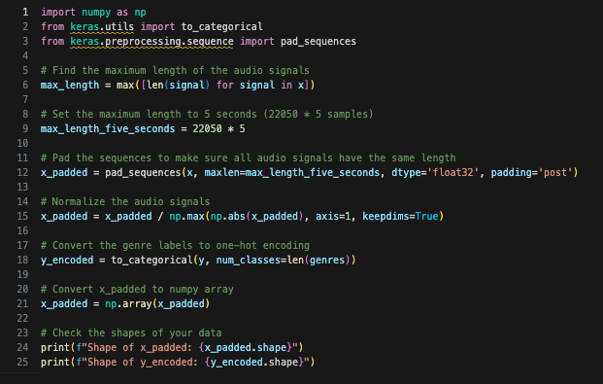
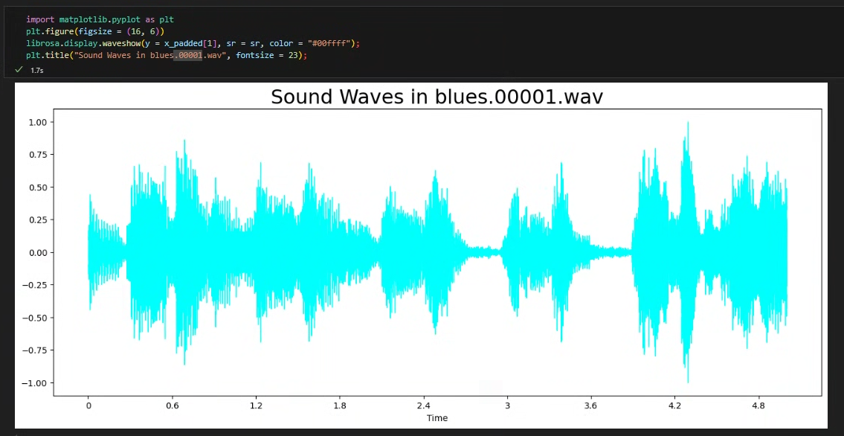
Raw audio-only music classification
Built an initial model using 5s audio clips.
Converted audio to flattened NumPy arrays without additional processing.
Tested all 10 genres at a 22,050 Hz sample rate:
SVC: 14% accuracy
Keras model: 21% accuracy after train-test split
Model failed due to lack of temporal information, leading to near-random predictions.

Slide 9
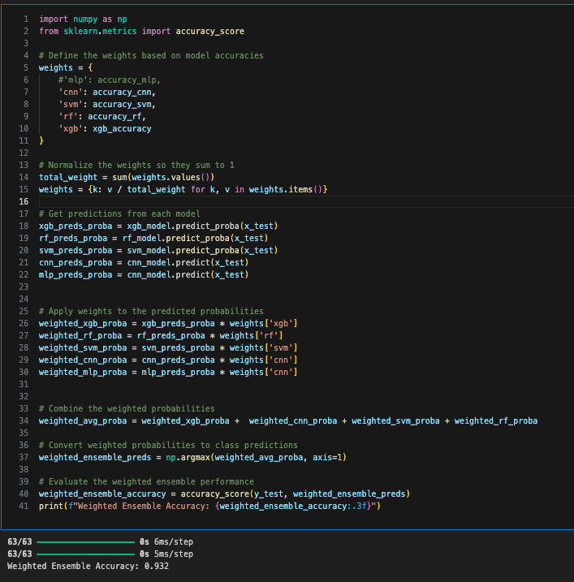
Weighted Ensemble
Each model is trained independently
Weights are defined based on the accuracy scored on the testing data
Weights are normalised, so that they sum to one
Each model creates a set of predictions for the test data
All predictions are counted, and the highest predicted class is finally predicted

Slide 10
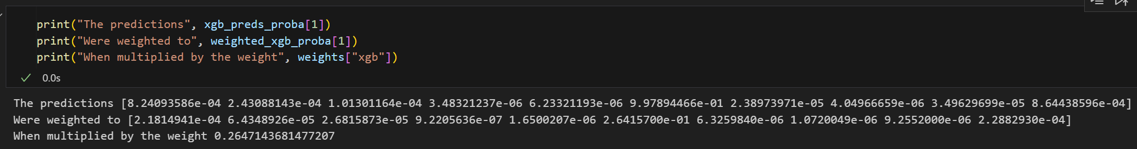
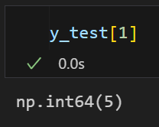
weighted Voting example
Class 0 | Class 1 | Class 2 | Class 3 | Class 4 | Class 5 | Class 6 | Class 7 | Class 8 | Class 9
0.00082409 | 0.00024309 | 0.00010130 | 0.00000348 | 0.00000623 | 0.99789447 | 0.00002390 | 0.00000405 | 0.00003496 | 0.00086444
0.00021815 | 0.00006435 | 0.00002682 | 0.00000092 | 0.00000165 | 0.26415700 | 0.00000633 | 0.00000107 | 0.00000926 | 0.00022883

Slide 11
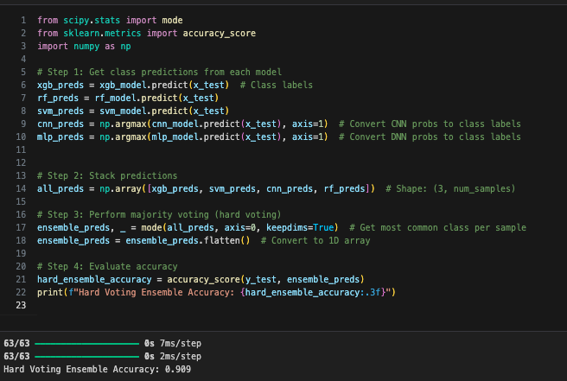
Hard voting ensemble
Each model is trained
Each model predicts a single class per piece of test data
The predictions are added together in a NumPy array matching the test data shape
The most voted prediction wins

Slide 12
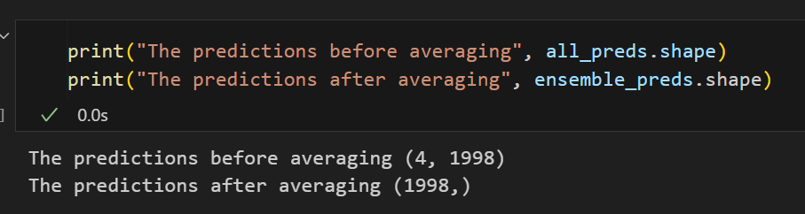
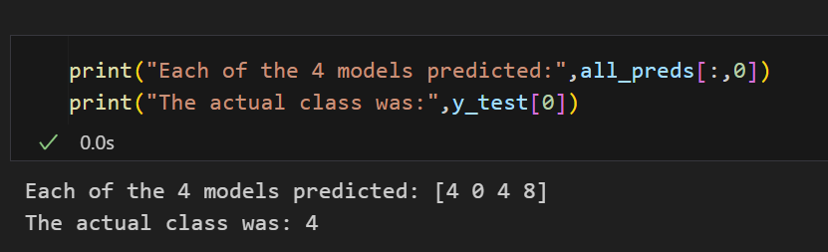
Hard Voting example
Each model creates a list of predictions with 1 class per piece of data
The predictions are added, and the class with
most votes wins
Unreliable with less models, because ties may happen, and are broken randomly (Usually the lowest class wins)

Slide 13
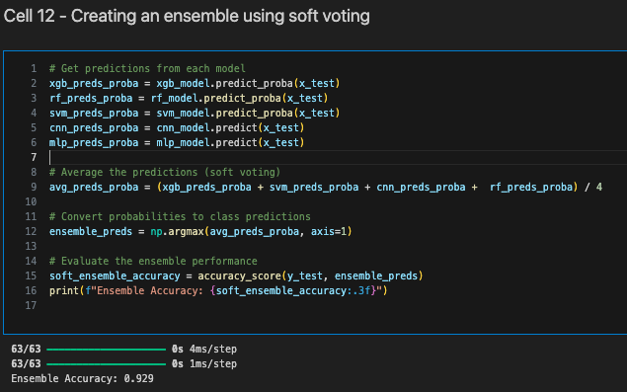
Soft voting ensemble
Each model is trained
Each model creates a prediction and a probability per data point
The probabilities are averaged into a final prediction
A final prediction is made

Slide 14
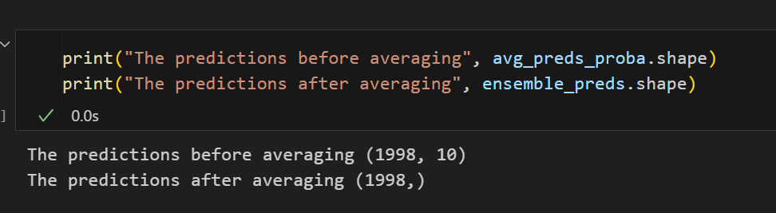
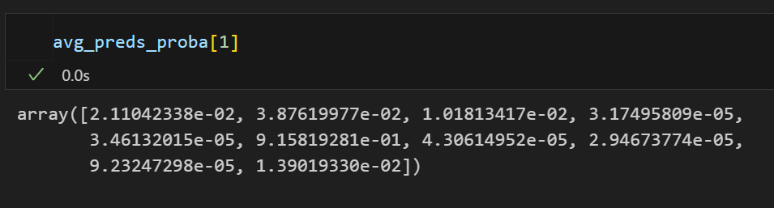
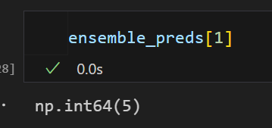
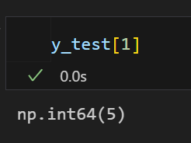
Soft Voting example
The prediction array is created as the length of the test data x the number of classes
A list of predicted probabilities is generated
Class 0 - 0.0211042338
Class 1 - 0.0387619977
Class 2 - 0.0101813417
Class 3 - 0.0000317495809
Class 4 - 0.0000346132015
Class 5 - 0.915819281
Class 6 - 0.0000430614952
Class 7 - 0.0000294673774
Class 8 - 0.0000923247298
Class 9 - 0.0139019330

Slide 15
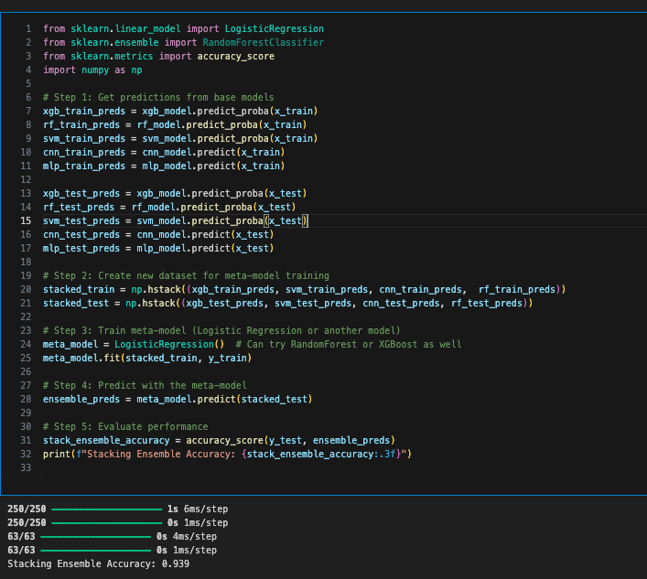
Stacked Ensemble
Get predictions from each model
Stack the base model predictions into NumPy stack
A meta model is trained on the stacked data
Make the prediction

Slide 16
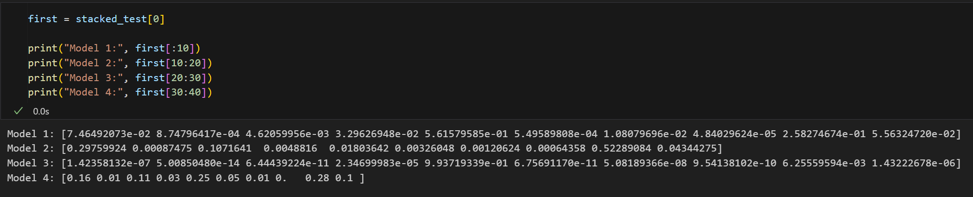
Stack prediction example
 | Class 0 | Class 1 | Class 2 | Class3 | Class 4 | Class 5 | Class 6 | Class 7 | Class 8 | Class 9
Model 1 | 0.07464929 | 0.00087480 | 0.00462860 | 0.03296269 | 0.56157959 | 0.00054959 | 0.01088797 | 0.00004840 | 0.25827467 | 0.05563247
Model 2 | 0.29759924 | 0.00087475 | 0.10716410 | 0.00488160 | 0.01803642 | 0.00326048 | 0.00120624 | 0.00064358 | 0.52289084 | 0.04344275
Model 3 | 0.00000014 | 0.00000000 | 0.00000000 | 0.00002347 | 0.99371934 | 0.00000000 | 0.00000005 | 0.00000000 | 0.00625560 | 0.00000143
Model 4 | 0.16 | 0.01 | 0.11 | 0.03 | 0.25 | 0.05 | 0.01 | 0.00 | 0.28 | 0.10
 | 0.13331217 | 0.00293739 | 0.05544818 | 0.01696694 | 0.45583384 | 0.01345252 | 0.00552357 | 0.00017300 | 0.26685528 | 0.04976916

Slide 17
Explaining the different audio-visual methods

Slide 18
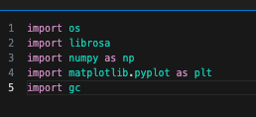
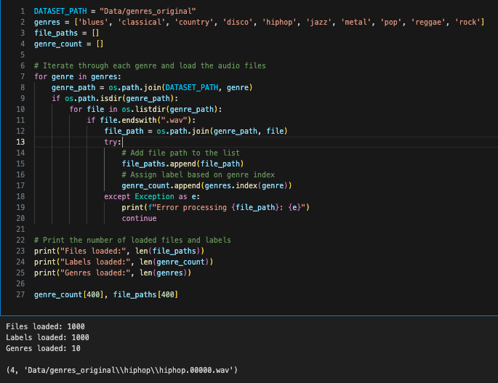
How we create the images (30 seconds)
Bring in all the imports
Grab the file paths for the raw .WAV files, and save them in a list, along with corresponding genres
Go through each music file, do the conversion, and save them

Slide 19
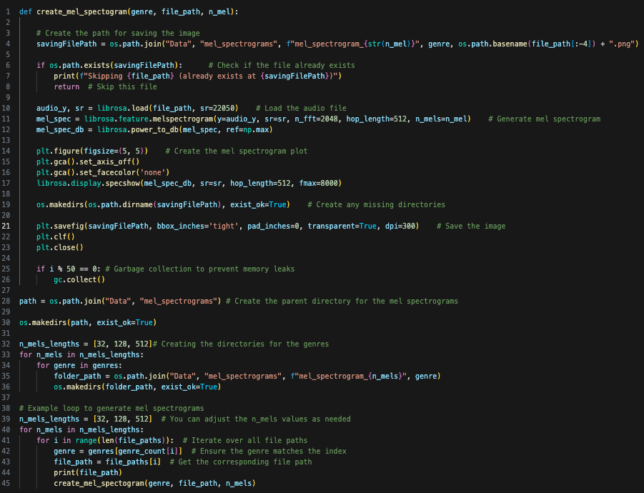
Generating mel-spectrogram images (30 seconds)

Slide 20
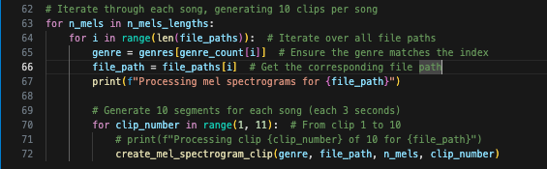
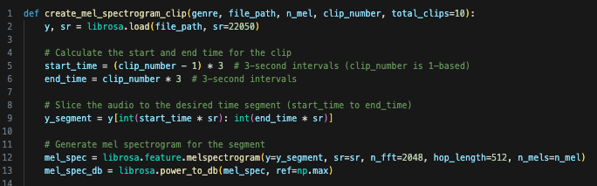
Generating Mel-Spectrograms (3 seconds)
Loop through each song 10 times (1 – 10)
2. Grab the specific clip of the track and save that
Note that the code for different image conversions relies on slightly different librosa methods. Bar this however, its the same structure for all converters

Slide 21
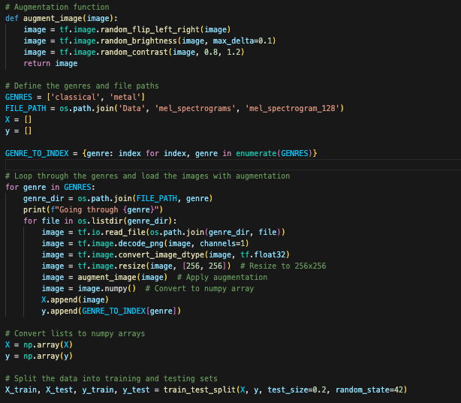
How we load data into the CNN (is this slide necessary?)

Slide 22
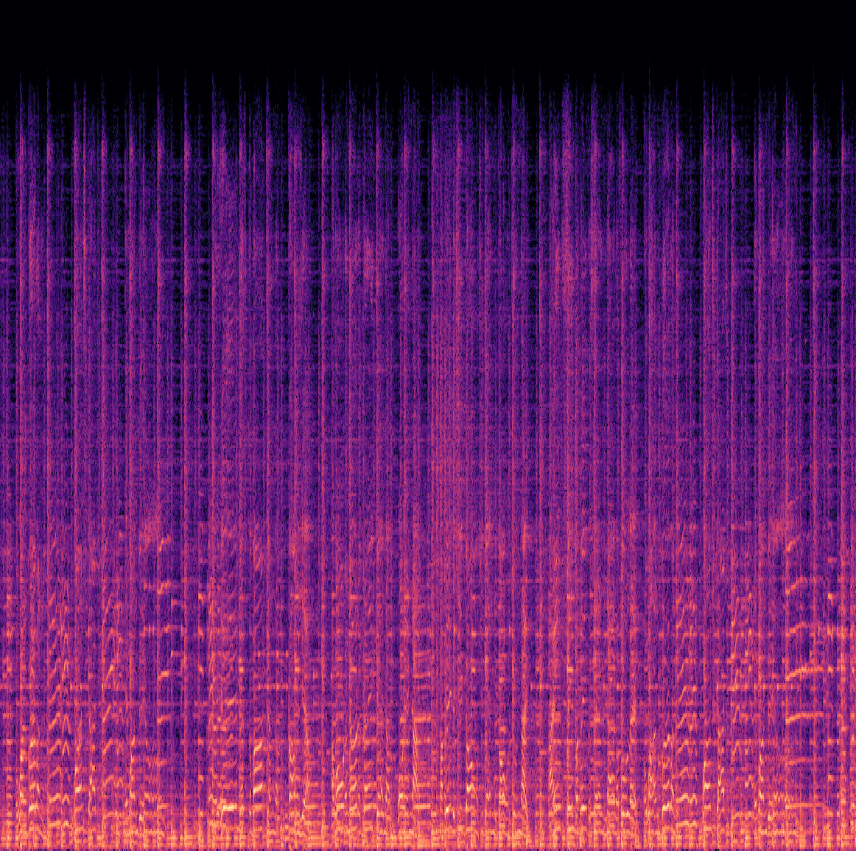
Spectrogram
A spectrogram shows frequency content over time, with time on the x-axis, frequency on the y-axis, and color indicating amplitude.
Adjusted hop lengths (256, 512) to assess accuracy, with smaller lengths offering more detail but higher risk of overfitting.

Slide 23
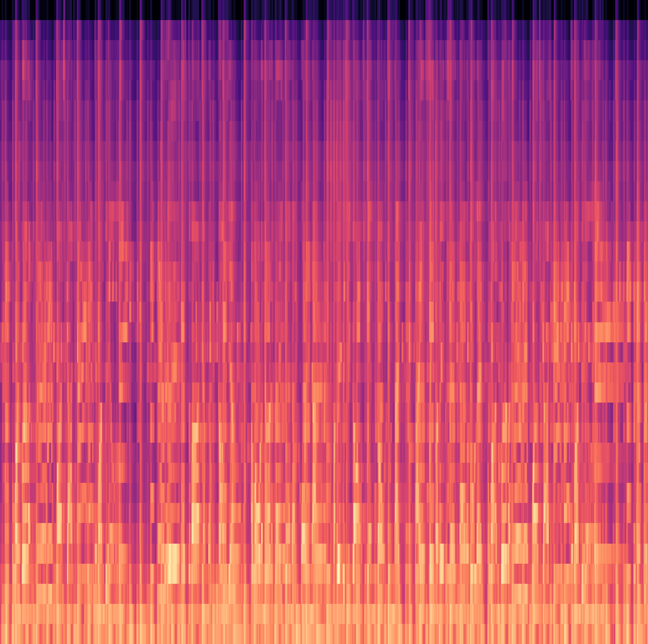
Mel-Spectrogram
A mel-spectrogram uses the mel scale, emphasizing lower frequencies for better speech/music analysis.
Tested n_mels values (32, 128, 512) to control frequency bin resolution. Higher n_mels provide finer details but are computationally expensive and may introduce inaccuracies.

Slide 24
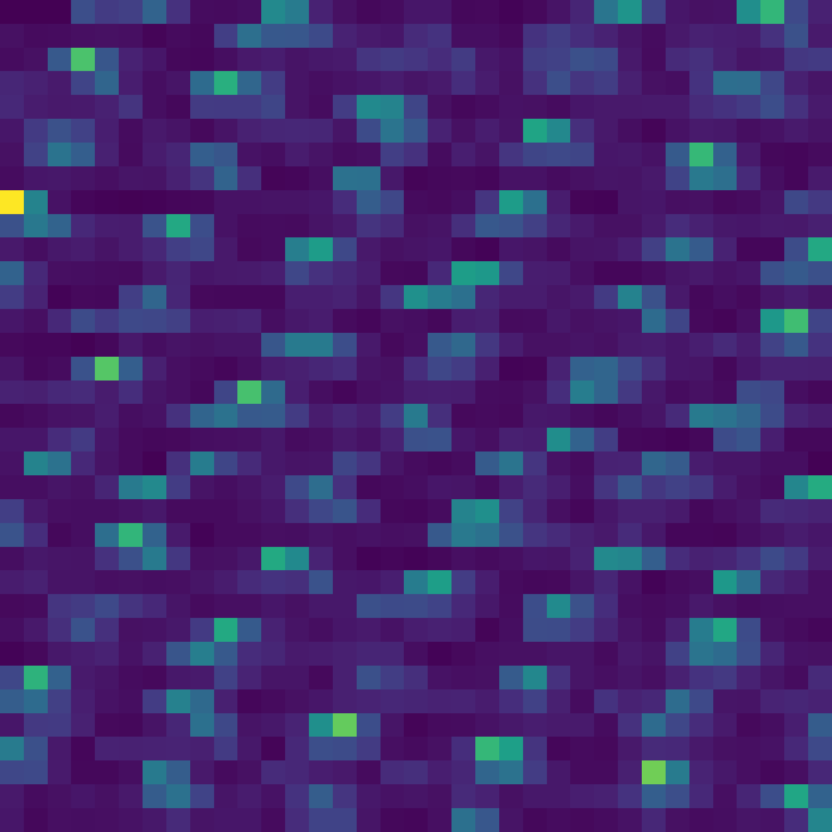
Onset Images
An Onset Image is a visual representation of sudden changes in a musical signal, highlighting the moments where new notes or beats begin.

Slide 25
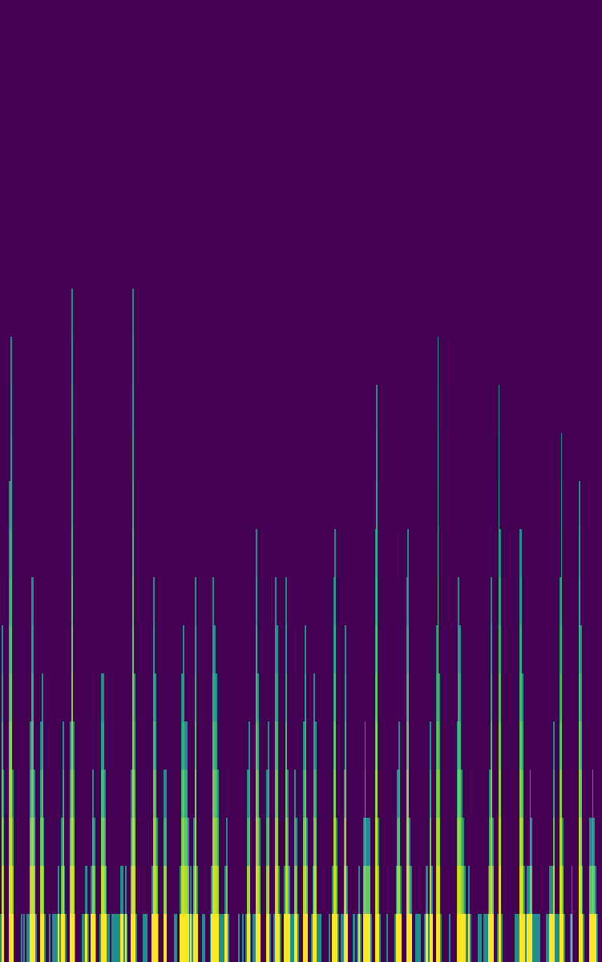
Onset heatmap
An Onset Heatmap Clip extends this by displaying onset strength over time as a heatmap, with intensity indicating the prominence of detected onsets.

Slide 26

tempogram
A tempogram visualizes the tempo variations of a signal over time, showing the dominant rhythmic patterns and beat fluctuations.

Slide 27
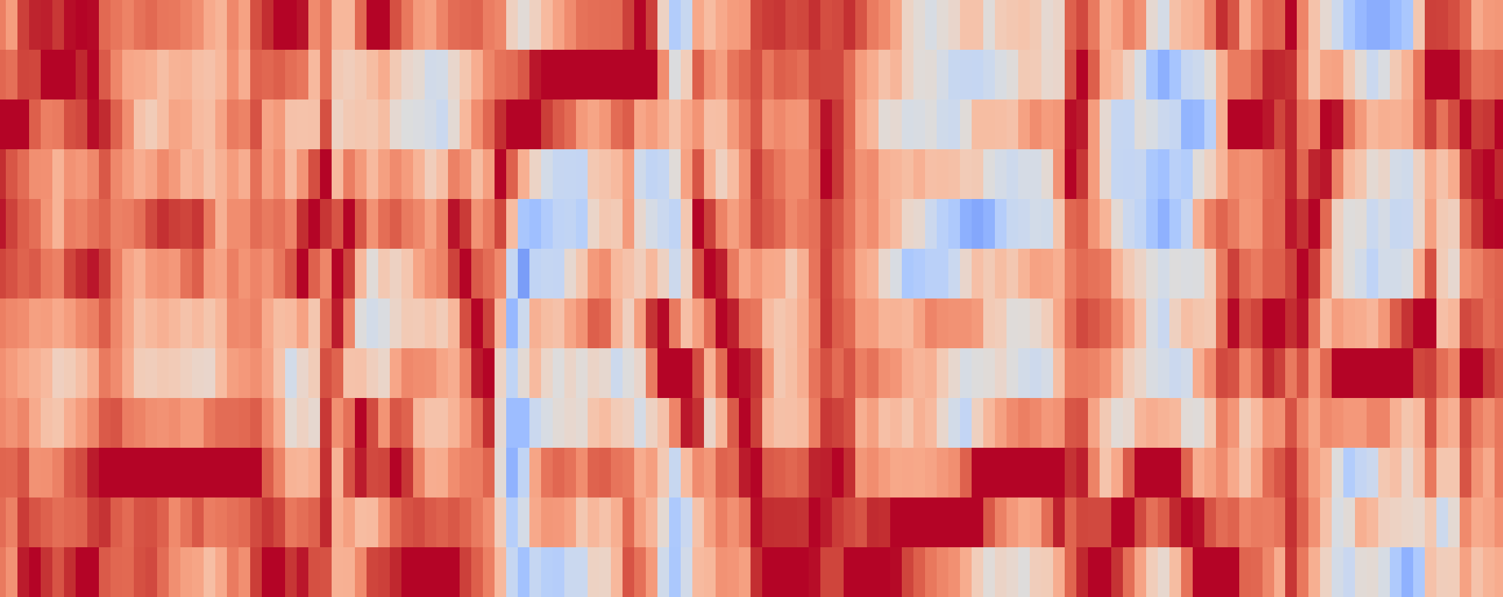
Chromagram
A chromagram shows the energy distribution across musical pitch classes over time, highlighting harmonic and melodic content regardless of octave.

Slide 28
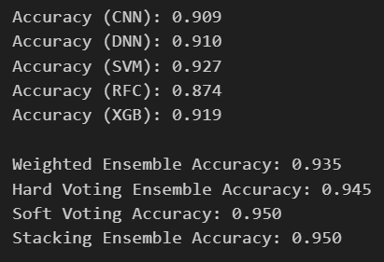
Models and Ensemble results using Extracted statistics
Generated a CSV with extracted features from song segments to evaluate model effectiveness on different data representations.
Used these results to guide integration into the final ensemble with image-based data.
Extracted statistics in the CSV include chroma shift means, spectral centroid, bandwidth variation, rolloff mean, harmony mean, and more.

Slide 29
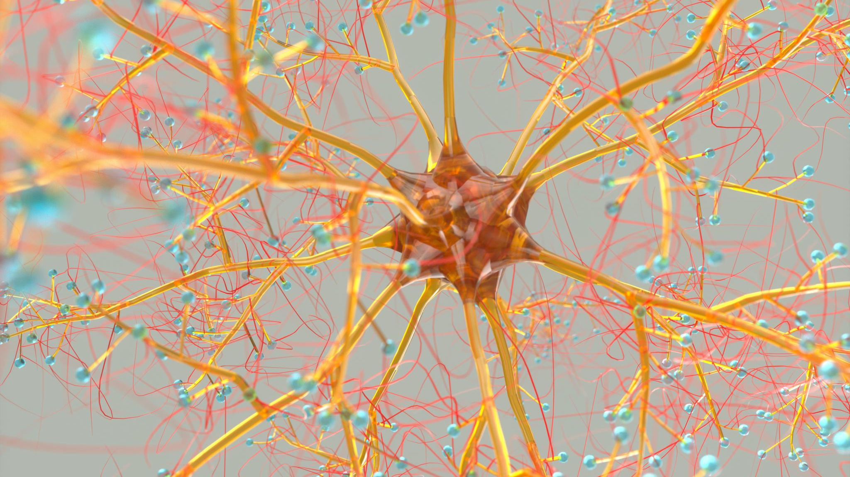
How we designed our neural network

Slide 30
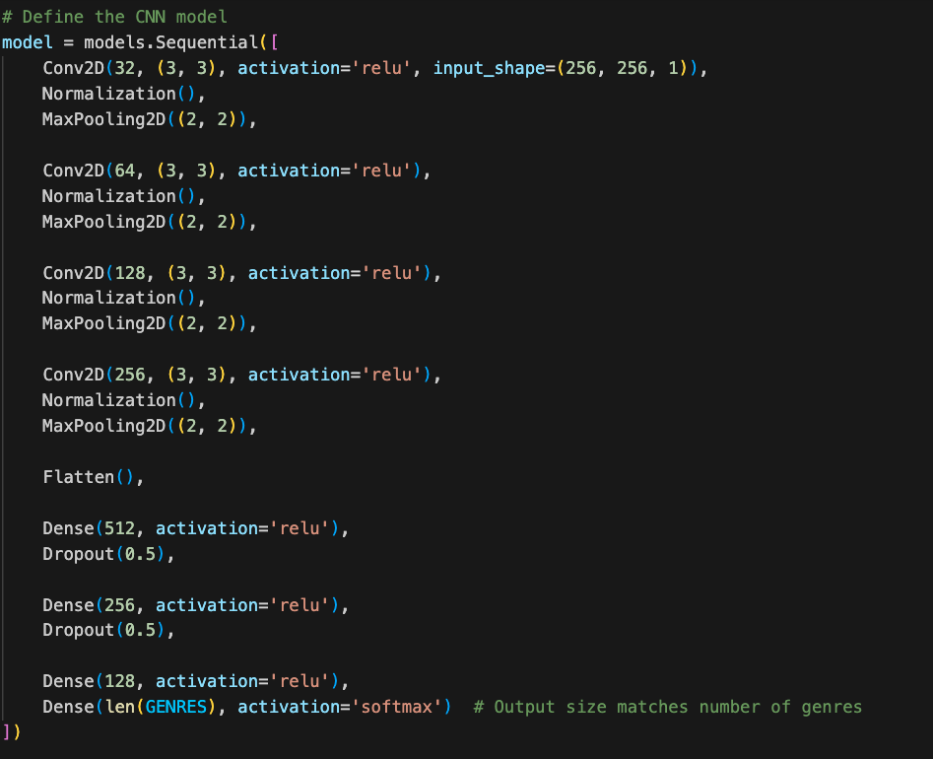
Structure of the CNN
We resized images to 256x256 and used four Conv2D layers with ReLU activation, increasing node count to match input shape.
Each Conv2D layer is followed by Normalization and MaxPooling2D layers.
We then use a Flatten layer before three Dense layers with ReLU activations, dropout for the first two, and a softmax output layer.

Slide 31
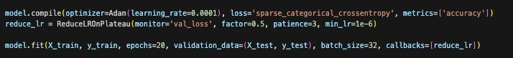
Topping off the CNN
We compile the CNN with Adam optimiser (along with a learning rate of 0.001) and introduce a ReduceLR in the case that the CNN suddenly stops learning, before finally fitting the model

Slide 32

Results from the data

Slide 33
All 10 Genres (10%) – 3 seconds
All spectrograms performed very well
Onset data is harder to know how effective it was
Chromagrams and Tempograms were of no use at all, and had many flaws
Model | Time | Specific Data Types | Genres | Result | As a Percentage | Notes
Spectrogram | 3 seconds | 512 | All 10 | 0.726 | 72.6
Mel-Spectrogram | 3 seconds | 512 | All 10 | 0.7 | 70
Mel-Spectrogram | 3 seconds | 128 | All 10 | 0.652 | 65.2
Spectrogram | 3 seconds | 256 | All 10 | 0.649 | 64.9
Mel-Spectrogram | 3 seconds | 32 | All 10 | 0.629 | 62.9
Onset Heatmap Clips | 3 seconds | N/A | All 10 | 0.343 | 34.3
Tempogram | 3 seconds | N/A | All 10 | 0.335 | 33.5
Chromagram (old) | 3 seconds | N/A | All 10 | 0.31 | 31
Onset Images | 3 seconds | N/A | All 10 | 0.31 | 31
Onset Heatmap Clips (old) | 3 seconds | N/A | All 10 | 0.222 | 22.2
Onset Images (old) | 3 seconds | N/A | All 10 | 0.192 | 19.2 | Guessed almost all were reggae
Tempogram (old) | 3 seconds | N/A | All 10 | 0.17 | 17 | Guessed almost all were jazz
Chromagram | 3 seconds | N/A | All 10 | 0.065 | 6.5 | Guessed all were classical

Slide 34
All 10 Genres (10%) – 30-seconds
Model | Time | Specific Data Types | Genres | Result | As a Percentage | Notes
Mel-Spectrogram | 30 seconds | 128 | All 10 | 0.465 | 46.5
Mel-Spectrogram | 30 seconds | 512 | All 10 | 0.46 | 46
Mel-Spectrogram | 30 seconds | 32 | All 10 | 0.39 | 39
Spectrogram | 30 seconds | 512 | All 10 | 0.39 | 39
Chromagram | 30 seconds | N/A | All 10 | 0.295 | 29.5
Spectrogram | 30 seconds | 256 | All 10 | 0.22 | 22
Tempogram | 30 seconds | N/A | All 10 | 0.135 | 13.5
Onset Heatmap Clips | 30 seconds | N/A | All 10 | 0.075 | 7.5 | Guessed all were classical
Onset Images | 30 seconds | N/A | All 10 | 0.065 | 6.5 | Guessed all were classical
Spectrograms were least effective in this one, but still effective
Others were very ineffective

Slide 35
Metal and Classic (50%) - 3 seconds
Exceptional performance on almost all models. Some even got 100% accuracy
Model | Time | Specific Data Types | Genres | Result | As a Percentage | Notes
Mel-Spectrogram | 3 seconds | 128 | Metal + Classic | 1 | 100
Spectrogram | 3 seconds | 256 | Metal + Classic | 1 | 100
Spectrogram | 3 seconds | 512 | Metal + Classic | 0.99 | 99
Mel-Spectrogram | 3 seconds | 512 | Metal + Classic | 0.985 | 98.5
Mel-Spectrogram | 3 seconds | 32 | Metal + Classic | 0.98 | 98
Chromagram | 3 seconds | N/A | Metal + Classic | 0.947 | 94.7
Onset Heatmap Clips | 3 seconds | N/A | Metal + Classic | 0.812 | 81.2
Onset Images | 3 seconds | N/A | Metal + Classic | 0.757 | 75.7
Tempogram | 3 seconds | N/A | Metal + Classic | 0.652 | 65.2

Slide 36
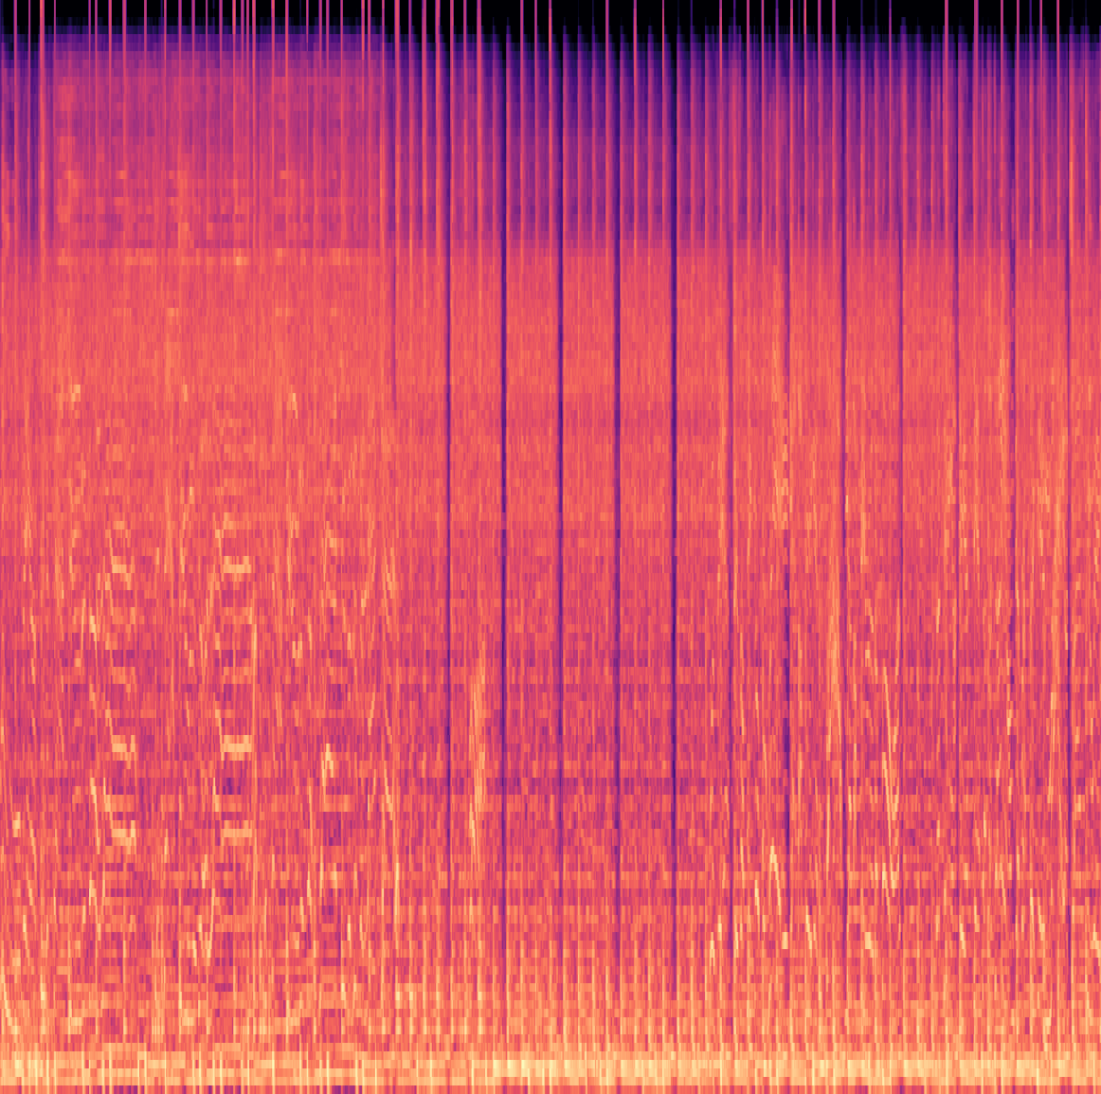
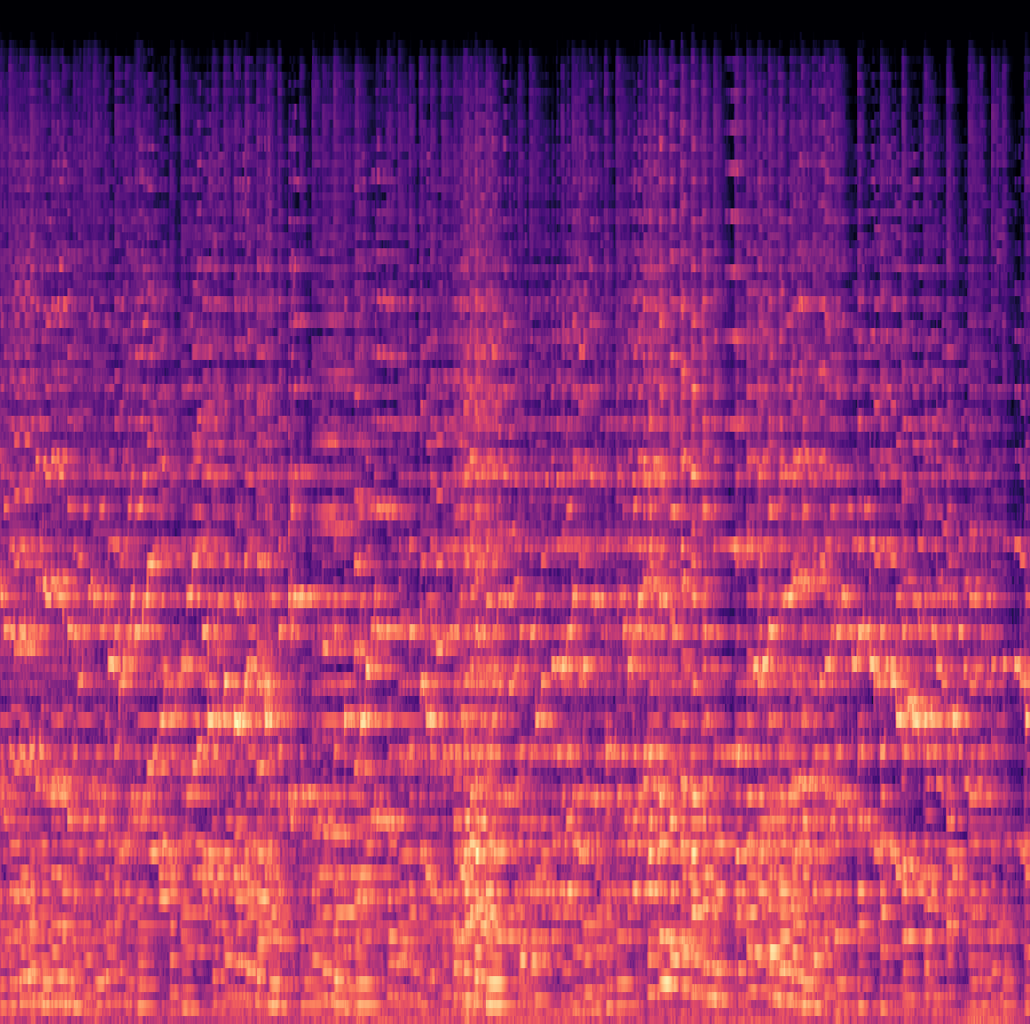
Metal and classic (50%) - 30 seconds
Model | Time | Specific Data Types | Genres | Result | As a Percentage | Notes
Mel-Spectrogram | 30 seconds | 512 | Metal + Classic | 1 | 100
Spectrogram | 30 seconds | 512 | Metal + Classic | 1 | 100
Spectrogram | 30 seconds | 256 | Metal + Classic | 1 | 100
Mel-Spectrogram | 30 seconds | 32 | Metal + Classic | 0.975 | 97.5
Mel-Spectrogram | 30 seconds | 128 | Metal + Classic | 0.9 | 90
Chromagram | 30 seconds | N/A | Metal + Classic | 0.525 | 52.5 | Guessed all were classical
Onset Images | 30 seconds | N/A | Metal + Classic | 0.525 | 52.5 | Guessed all were classical
Tempogram | 30 seconds | N/A | Metal + Classic | 0.475 | 47.5 | Guessed all were metal
Onset Heatmap Clips | 30 seconds | N/A | Metal + Classic | 0.45 | 45
Only spectrograms performed well
Example of Metal vs Classical Mel-Spectrogram:

Slide 37
Disco and Pop (50%) - 3 seconds
All spectrograms performed very well. Onset heatmap clips also performed well, but not quite as well
Other genres did not perform as well, and its difficult to know how useful they are as metrics for success
Model | Time | Specific Data Types | Genres | Result | As a Percentage | Notes
Spectrogram | 3 seconds | 256 | Disco + Pop | 0.938 | 93.8
Mel-Spectrogram | 3 seconds | 128 | Disco + Pop | 0.918 | 91.8
Mel-Spectrogram | 3 seconds | 512 | Disco + Pop | 0.885 | 88.5
Spectrogram | 3 seconds | 512 | Disco + Pop | 0.853 | 85.3
Mel-Spectrogram | 3 seconds | 32 | Disco + Pop | 0.848 | 84.8
Onset Heatmap Clips | 3 seconds | N/A | Disco + Pop | 0.735 | 73.5
Tempogram | 3 seconds | N/A | Disco + Pop | 0.723 | 72.3
Onset Images | 3 seconds | N/A | Disco + Pop | 0.65 | 65
Chromagram | 3 seconds | N/A | Disco + Pop | 0.475 | 47.5 | Guessed all were Pop

Slide 38
Disco and Pop (50%) - 30 seconds
Model | Time | Specific Data Types | Genres | Result | As a Percentage | Notes
Spectrogram | 30 seconds | 512 | Disco + Pop | 0.75 | 75
Tempogram | 30 seconds | N/A | Disco + Pop | 0.55 | 55 | Guessed almost all were disco
Chromagram | 30 seconds | N/A | Disco + Pop | 0.525 | 52.5
Mel-Spectrogram | 30 seconds | 32 | Disco + Pop | 0.525 | 52.5
Mel-Spectrogram | 30 seconds | 128 | Disco + Pop | 0.525 | 52.5
Mel-Spectrogram | 30 seconds | 512 | Disco + Pop | 0.525 | 52.5
Onset Heatmap Clips | 30 seconds | N/A | Disco + Pop | 0.525 | 52.5
Spectrogram | 30 seconds | 256 | Disco + Pop | 0.525 | 52.5
Onset Images | 30 seconds | N/A | Disco + Pop | 0.475 | 47.5 | Guessed all were pop
Much less successful results from this – only spectrogram 512 did somewhat decently
Probably due to a lack of training/testing data

Slide 39

Five Randon Genres (20%) - 3 seconds
Spectrograms still the most effective by far
Model | Time | Specific Data Types | Genres | Result | As a Percentage | Notes
Spectrogram | 3 seconds | 512 | 5 random | 0.829 | 82.9
Mel-Spectrogram | 3 seconds | 512 | 5 random | 0.816 | 81.6
Mel-Spectrogram | 3 seconds | 128 | 5 random | 0.76 | 76
Spectrogram | 3 seconds | 256 | 5 random | 0.739 | 73.9
Mel-Spectrogram | 3 seconds | 32 | 5 random | 0.706 | 70.6
Chromagram | 3 seconds | N/A | 5 random | 0.57 | 57
Onset Heatmap Clips | 3 seconds | N/A | 5 random | 0.534 | 53.4
Onset Images | 3 seconds | N/A | 5 random | 0.495 | 49.5
Tempogram | 3 seconds | N/A | 5 random | 0.467 | 46.7

Slide 40
Five random genres (20%) - 30 seconds
Model | Time | Specific Data Types | Genres | Result | As a Percentage | Notes
Mel-Spectrogram | 30 seconds | 512 | 5 random | 0.67 | 67
Spectrogram | 30 seconds | 256 | 5 random | 0.63 | 63
Mel-Spectrogram | 30 seconds | 128 | 5 random | 0.56 | 56
Mel-Spectrogram | 30 seconds | 32 | 5 random | 0.49 | 49
Onset Images | 30 seconds | N/A | 5 random | 0.44 | 44
Spectrogram | 30 seconds | 512 | 5 random | 0.35 | 35
Onset Heatmap Clips | 30 seconds | N/A | 5 random | 0.32 | 32
Tempogram | 30 seconds | N/A | 5 random | 0.3 | 30
Chromagram | 30 seconds | N/A | 5 random | 0.14 | 14
Less effective than the 3 second version

Slide 41

General results from single image CNNs
Spectrogram and Mel-Spectrogram were most effective for audio classification.
Chromagram, Tempogram, and Onsets usefulness in CNNs was unclear.
3-second models were more accurate.
Classical + Metal binary comparison outperformed Disco + Pop due to more significant genre differences.
Mel-Spectrogram 32 was overall the least effective Mel-Spectogram model
All Spectrogram models had similar effectiveness. Many chromograms and tempograms over-predicted single genres.

Slide 42
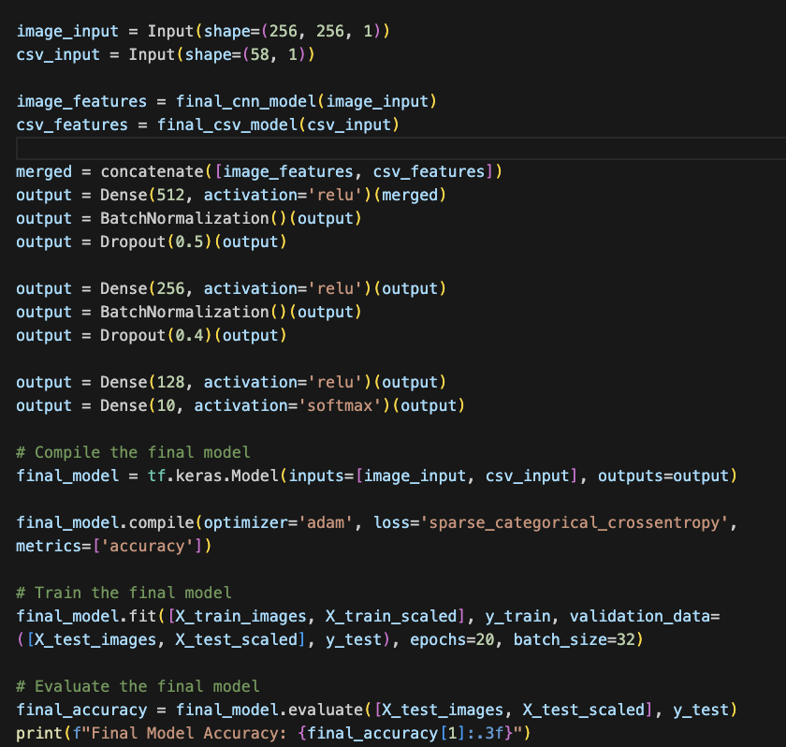
CNN + features ensemble
What happens when we combine our most successful 30 second CNNs with ensemble data?
Models used:
Image CNN + Conv1D CSV CNN
We had to adjust our models slightly when combining them – grab the first part of both models, then we combine them within a final model
We tested these different results on:
Mel-Spectrograms (32, 128 and 512)
Spectrogram (256, 512)

Slide 43
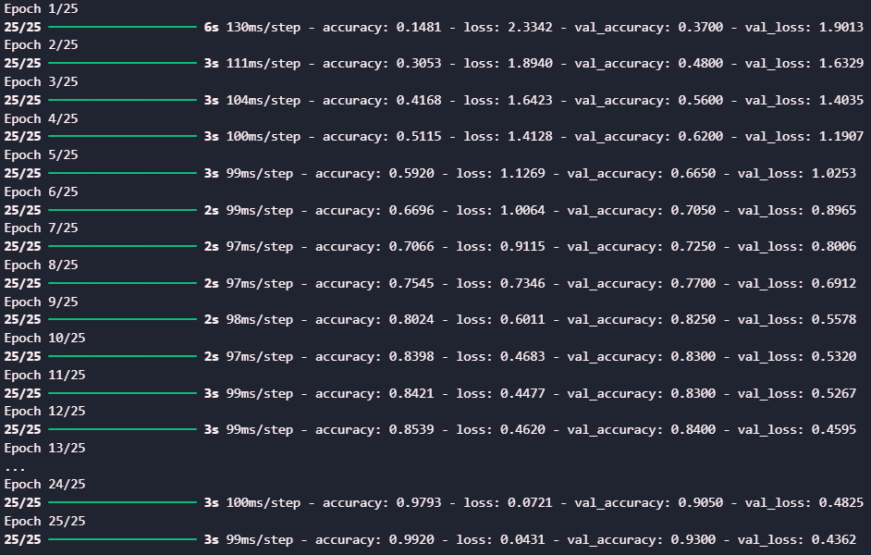
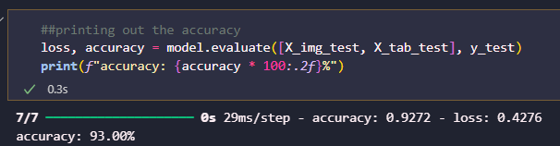
This is the result of running an ensemble that used both the features, and also a spectrogram
We determined that 25 was the optimal number of epochs to run the model for
It returned an accuracy of 0.93

Slide 44
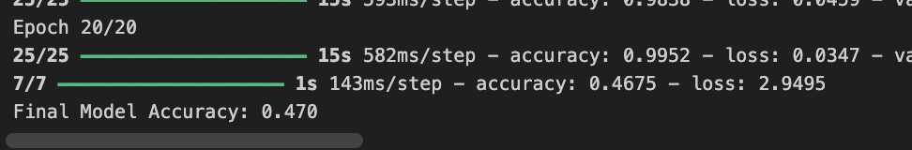
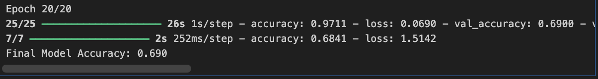
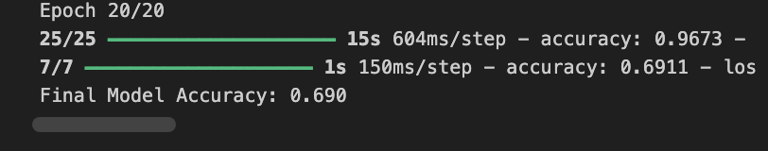
Mel-Spectrograms
Final model accuracy for 32:
0.470 (47% accuracy after 20 epochs)
Final model accuracy for 128:
0.690 (69% accuracy after 20 epochs)
Final model accuracy for 512:
0.690 (69% accuracy after 20 epochs)

Slide 45
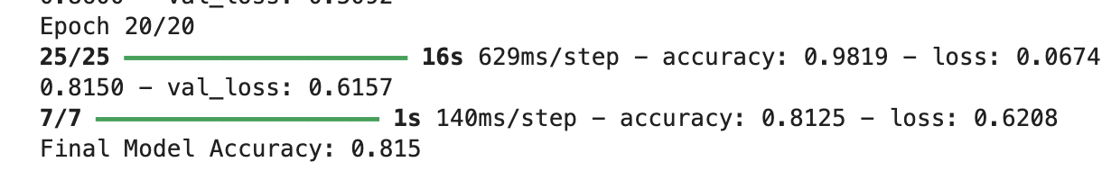

Spectrograms
Final model accuracy for 256:
0.815 (81.5% accuracy after 20 epochs)
Significantly more accurate than the 512
Final model accuracy for 512:
0.535 (53.5% accuracy after 20 epochs)
Massive reduction in accuracy with the 512 model

Slide 46
Conclusions
Combining the image CNN with CSV lead to a higher accuracy on average than just the CNNs on their own. Particularly significant jump in accuracy for Spectrogram 256
Changes were made to the CNNs and the image generation tools in the last couple of weeks, but we didn't have enough time to investigate these in detail to try and fix them
Probably had a fall in accuracy due to later changes in our code. May require additional tests/adjusting the CNNs for more accurate readings
Had issues with combining models (only able to combine image CNN and Conv1D CNN) – may have wanted to try different combinations of models

Slide 47
Interesting challenges along the way
Our initial dataset had a corrupted track (jazz.00054.wav), which we later retrieved by contacting the original creator.
Some songs were 29 seconds, so padding was added for consistency.

Slide 48
What we could have done in the future
Build more complex CNNs with different structures adjusting variables like hop length and n_mels during training, as well as shape of the CNNs
Test different input sizes (not just 256x256) to adjust accuracy.
Explore new techniques to extract more data, including generating more statistical data on top of images.
Increase training and testing data by adding more songs and testing different song durations. Test full-length songs to further confirm accuracy

Slide 49

Thank you

